Slide 1

Learning to Read and Write in Reception Class
Parents/Carers Workshop
Tuesday 19th October 2021

Slide 2
Early Years Foundation Stage
Communication and Language
Listening and Attention and Understanding
Speaking
Literacy
Word Reading
Comprehension
Writing
Physical Development
Fine Motor
English
Literacy

Slide 3


Reading
Reading for enjoyment/pleasure
STOP, DROP and READ story time
Reading for information
Research, finding things out
Reading with understanding
Comprehension
Story Telling
Narrative and vocabulary
Making up stories
Re-reading
Repetition, repetition, repetition!

Slide 4
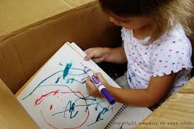
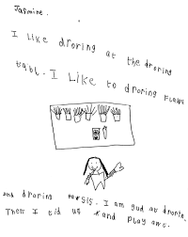
Writing
Mark Making and Writing for enjoyment
Mark Making and giving meaning to marks made/ letters written
Writing for a purpose - a card for Daddy, a shopping list, my story
Look at writing/letters/sounds and showing understanding
Communication and Language
Literacy – Writing
Physical Development – Fine Motor

Slide 5
PHONICS
“Phonics refers to a method for teaching speakers of English to read and write their language. It involves connecting the sounds of spoken English with letters or groups of letters.” Literacy Trust

Slide 6
Phonics at St John’s
Taught daily and systematically
High priority
Use Letters and Sounds programme currently – Essential Letters and Sounds from Autumn 2
Explicitly taught from Reception – Year 2 (beyond?)
Phases 1-6 that all children progress through
Phase 1 supports children with listening and ‘tuning into/distinguishing sounds’ KEY on entry into school
Phonics teaches sounds as well as spelling patterns and tricky words
How we teach reading and writing for all children
Reading = access to rest of curriculum
‘Keep up’ not ‘catch up’

Slide 7
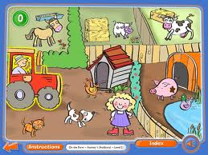


Phase 1
‘Tuning in’ to sounds
Listening for sounds
Sounds in the environment around us
Syllables and chunks of sounds
Onset and rime
Nursery rhymes and rhyming words
Alliteration
‘Break up’ and ‘push sounds together’ orally
LISTENING AND ATTENTION SKILLS

Slide 8

How can I help in Phase 1?
Singing nursery rhymes and songs
Talking to your child – making noises, changing your voice when reading
Hearing a sound – What made that sound?
Talking about sounds – What kind of sound is that?
Making noises – using every day objects/voices/body to make noise!!
Reading daily to and with children – Share books
Pointing out letters in the environment/ child’s name
Silly sentences and rhyming sentences

Slide 9

Research says…..

Slide 10
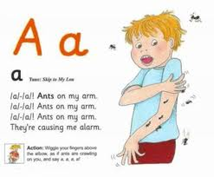
Phase 2
Children learn initial sounds all taught with an action/story/song
SOUNDS (not letter names!)
Children are introduced to 6 tricky words – cannot be sounded out. Just learn!
Taught to blend for reading (push sounds together) and segment for writing (break up sounds)
Taught to form letters correctly – St John’s way! Print ready to start cursive when ready

Slide 11
No schwar-ing!
m muh c cuh
wif wiv with
Short and bouncy sounds!
“Pure” sounds
https://www.youtube.com/watch?v=UCI2mu7URBc

Slide 12
Adult Child
ABC abc
C-A-T c-a-t
The name is _____ the sound is___
SOUND NOT LETTER!
Knowing the alphabet is not important at all in Reception class.

Slide 13
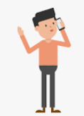
Phoneme unit of sound what you hear/say

Slide 14
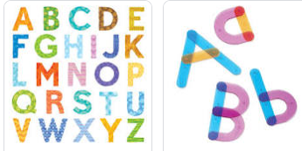
Grapheme letter shape what you write/see

Slide 15
Segmenting
Breaking the word up into units of sound
(not letters, groups of sound)
Sounding out
For writing

Slide 16
Blending
Push the unit of sounds back together SMOOTHLY for reading
Sounds need to be blended smoothly and clearly so words are read correctly with sounds in order
Speed blending - doing this quickly without any gaps between the sounds

Slide 17
Reading finger
Tracking the letters/words/text
Child must hold the book and be tracking – don’t do it for them
Hand-over-hand to support accurate tracking (not adult using their finger)
Rereading once sounded out – go back to the beginning

Slide 18
Tricky words
Word box words
CANNOT be sounded out
Breaks the rules of phonics!
the is not th-e
Said is not s-ai-d but is sed
“You just have to learn what it says! (sight reading)
Tip: Taught through mnemonics – Big Elephants Can’t Add Up Sums Easily

Slide 19
How can I help in Phase 2?
Reading daily at home – phonics books carefully matched to their phonics ability will be sent home (changed every Monday) READING FINGER
Write in Reading Record every time your child is heard at home – let us know how they are getting on
Rehearse tricky words – Word Box words
Model sounds clearly and accurately – use the internet to help you (do not schwar!)
Access online ebooks through Oxford Owl
Repetition, repetition, repetition – Re read books!
Little and often is key!

Slide 20
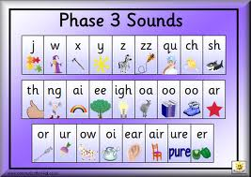
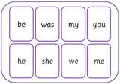
Phase 3
Children begin to learn:
digraphs – 2 letters that make 1 sound
trigraphs – 3 letters that make 1 sound
More tricky words are taught
Confidently blending for reading and segmenting for writing (beginning, middle and end sounds)

Slide 21
How can I help in Phase 3?
Continue…..
Daily reading of school reading book
Daily practice of sounds in folder/flashcards (and return to school for updating)
Daily practice of tricky words in word box
Look for letters/digraphs/trigraphs and talk about the sounds
Speed blending - ‘Push sounds together’ quickly when reading so more accurate and confident
Spot tricky words in books/print – accurately identify them and use when writing
READING FINGER and rereading sentence once sounded out

Slide 22
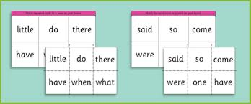
Phase 4
Children consolidate all the sounds learnt in phases 2 and 3 – SPEED BLENDING
Blends are taught – fl, gr, st, str, tch etc
More tricky words are taught

Slide 23

Comprehension and Understanding
PHONICS SKILLS AND UNDERSTANDING BOTH IMPORTANT -Communication and Language!
Vocabulary -reading books develops this
Ask questions about the book/pictures/story
What happened to….?
Why did the …… ?
How can you tell it is winter?
Where in the book is the word that tells me the boy is sad?
Can you find me a capital letter?
Where is there an e grapheme?
Why is there a full stop there?

Slide 24
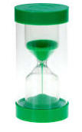
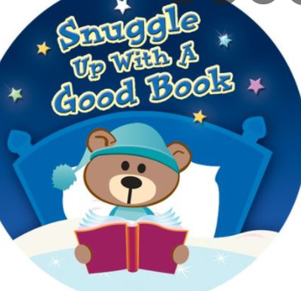
Reading is not a chore!
Every day – little and often
Short and sharp – set a timer!
Positive and encouraging
Quiet, calm space
‘Timetable’ it in – make sure your child knows when it will happen
Enjoyable

Slide 25
Resources for you to use at home
Book bag – Share Book, Phonics reading book
Word box – Updated once taught in school and rehearsed at home (reading first then writing)
Phonics flashcards – grapheme cards to rehearse letter sounds (automatic and fluently)
Grapheme sheets in folder – Letter formation practice once grapheme has been taught in school
Tapestry posts – Updated to reflect when new sounds/words have been taught in school. Online resource links shared
Name cards – Showing correct letter formation
Oxford Owl – Online ebooks. More information after halfterm

Slide 26
Please, please, please…..
All book bags, books, reading records, phonics flashcards, folders, word boxes to be in school
EVERY DAY
Keep everything in the book bag at home so nothing gets lost!

Slide 27

Thank you for listening!

