Slide 1
Religious Education
At St John’s C of E Academy

Slide 2
The Big Frieze

Slide 3
The Big Frieze at St John’s
Rowan Class – Creation
Ash Class - Incarnation

Slide 4
The Big Frieze at St John’s
Beech Class - Gospel
Chestnut Class – The Fall

Slide 5
The Big Frieze at St Johns
Hazel Class– Kingdom of God
Elm Class - Salvation

Slide 6
The Big Frieze at St John’s
Oak Class – People of God
THANK YOU!!
A huge thank you to all of you. You have done brilliantly and they look absolutely amazing.

Slide 7
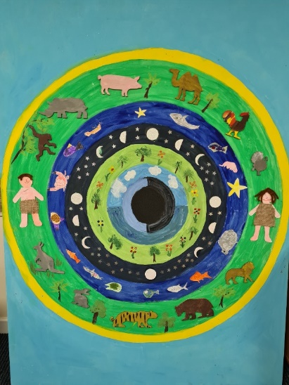
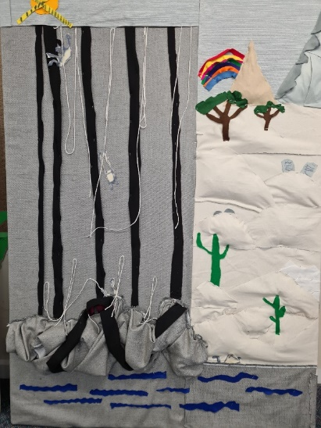
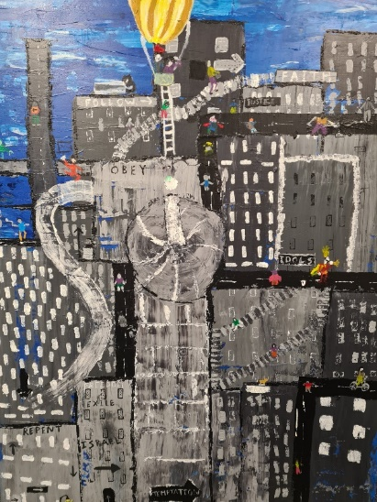
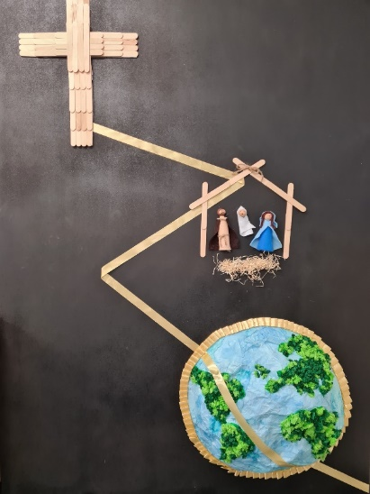
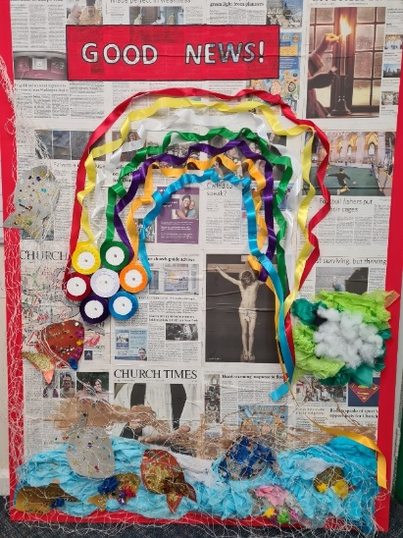
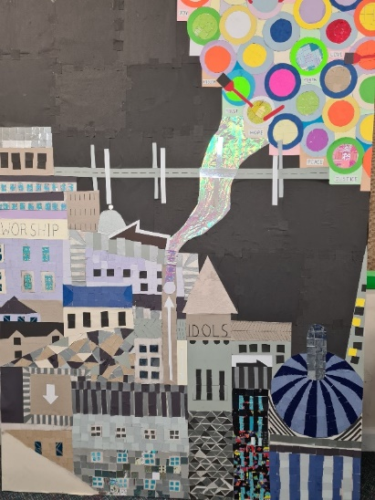
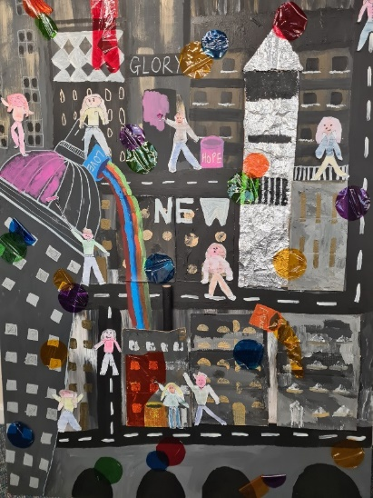
The Big Frieze at St Johns

